Slide 1
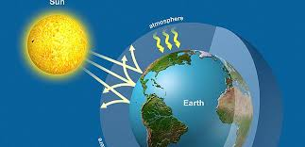
GREENHOUSE EFFECT: CAUSES AND IT’S IMPACT
DR. PRAVEEN KUMAR
ASSTSTANT PROFESSOR
DEPARTMENT OF ZOOLOGY
D. N. COLLEGE, MEERUT

Slide 2
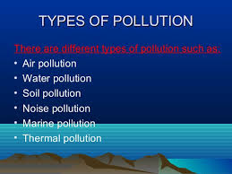
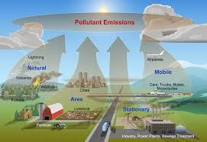
TEMPERATURE INCREASE
(GREENHOUSE EFFECT)
AIR POLLUTION
INCREASE
AIR POLLUTANTS
CO2

Slide 3
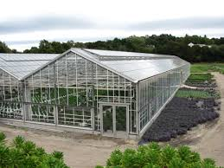
GREENHOUSE EFFECT
Artificial or manmade greenhouse is made-up of by glass walls. Incoming UV radiation easily passes through the glass walls of a greenhouse and is absorbed by the plants and hard surfaces inside. Weaker IR radiation, however, has difficulty passing through the glass walls and is trapped inside, thus warming the greenhouse. This effect lets tropical plants thrive inside a greenhouse, even during a cold winter.
The greenhouse effect has been widely used to describe the trapping of excess heat by the rising concentration of CO2 in the atmosphere. The CO2 strongly absorbs IR and doesn’t allow as much of it to escape into space

Slide 4
GREENHOUSE GASES
CO2 and other greenhouses gasses act like a blanket, absorbing IR radiation into outer space. The net effect is the gradual heating of earth’s atmosphere. These greenhouses include followings:
CO2 (Carbon di oxide)
CH4 (Methane)
N2O (Nitrous oxide)
Fluorinated Gases
CFC (Chlorofluorocarbons)
PFC (Perfluorocarbons)
SF6 (Sulphur hexafluoride)

Slide 5
CAUSES OF GREENHOUSE GASES EMISSION
Fuel Combusion.
Energy Industries.
Manufacturing Industries and construction.
Vehicle transport and automobiles.
Fugitive emissions from fuels.
Burning of solid fuels.
Use of oil and natural gas.
Mineral products.
Chemical Industries.
Metal production.
11. Production of halocarbons and sulphur hexafluoride.
12. Consumption of halocarbons and sulphur hexafluoride.
13. Solvent and other products used.
14. Enteric fermentation.
15. Manure management.
16. Rice cultivation.
17. Agricultural solids.
18. Prescribed burning of savannas.
19. Field burning of agricultural residues.
20. Solid waste disposal on land.
21. Waste water handling.
22. Waste incineration.

Slide 6
FACTORS AFFECTING GREENHOUSE GAS’S EFFECT
How much of these gases are in the atmosphere.
Concentration or abundance, is the amount of particular gas in the air.
How long do they stay in the atmosphere.
How strongly do they impact global temperature.

Slide 7
IMPACTS OF GREENHOUSE EFFECT
Environment:-
The heat trapped by CO2 and other greenhouse gases has increased surface temperature by 0.75°C (1.4°F) over the last 100years.
Increased temperature is harming the environment in several ways including-
The desertification.
Increased melting of snow and ice.
Sea level rises.
Stranger storm and extreme events.
Ocean Acidification:-
Increase in CO2 levels have made the world oceans 30% more acidic since the industrial revolution
CO2 + H2O H2CO3
Smog and Ozone Pollution:-
Long-term ozone expose has also been shown to reduce life expectancy, 362000 – 700000 of annual premature cardiopulmonary deaths worldwide are attributable to ozone. Recent studies estimate that the global yields of key staple crops like soybean, maze (Corn) and wheat, are being reduced by 2-15% due to present day ozone exposure.
Global Warming:-
Atmosphere CO2 levels have increased by more than 40% since the beginning of the Industrial revolution, from about 280parts per million (ppm) in the 1800 to 400ppm today.
Each 1 degree rise in the temperature of the world’s ocean in the equivalent to 1.4billion 1megaton atom bombs, that is a lot of energy. This tremendous amount of devastating energy, generating global warming.

Slide 8
IMPACTS OF GREENHOUSE EFFECT
Ozone Layer Depletion:-
Nitrous oxide damages the ozone layer. CFCs and a many other gases that are harmful for the ozone layer were banned by the montred protocol (MP) which has reduced their atmospheric concentration. Nitrous oxide is not restricted by the MP, so while the levels of other ozone depleting substances are decline, nitrous oxide levels are containing to grow.
Changes to Plant Growth and Nutrition Levels:-
CO2 concentrations were raised by around by 50% increased crop growth by around 15%. Higher levels of CO2 makes carbon more available, but plants also need other nutrients (like nitrogen, phosphorus, etc) to grow and survive without increases in those nutrients as well, the nutritional quality of plants will decrease. In different experiments with elevated CO2 levels, protein concentrations in wheat, rice, barley and potato tubers, decreased by 5-14%.
Forests:-
Heat waves are likely to increase in frequency and severity, resulting in higher risk of forest fire.
Wild Life:-
Many wildlife species will have difficulty adapting to a warmer climate and will likely be subject to greater stress from diseases and invasive species.
Human Health:-
There may be greater risk of respiratory and cardiovascular problems and certain types of cancers, as temperature rises and exceed air pollution. The risk of water, food, vector and rodent borne decease may increase.
Economic Impacts:-
Agriculture, forestry, tourism and recreation may be affected by changing weather patterns. Human health impacts are expected to place additional economic stress on health and social support systems.

Slide 9
WHAT WE SHOULD DO?
Through government policies.
Role of NGOs.
Public Awareness.
GWP Rating.
Use of Alternative eco friendly energy resources.

